Slide 1

Which 4 room HDB listings deserve the premium marketing package?
DBA5106 PROJECT 2 [21] · [Samuel Chan] & [Yang Yi]
How predictions are used
Cost of each error
A seller signs a 4-room flat with the agency
The model scores P(premium) for the flat
P ≥ t → premium package; P < t → standard service
 | Package given | Standard service
Premium flat | 0 | 3 · missed (FN)
Not premium flat | 1 · wasted (FP) | 0
Premium Flats= price per sqm above the median of 4-room sales in the same town and quarter (49.6% of sales).
Loss equation → L(t) = (1·FP + 3·FN) / n per listing
Costs in units of one package; 3:1 is our assumption. For calibrated P, the optimum is t* = 1 / (1 + 3) = 0.25.
*Premium Package: Photoshoot, featured ads and senior agent
DBA5106 Project 2
Notes:
Slide 1 · Which 4-room HDB listings deserve the premium marketing package?
Speaker A · about 2.5 minutes · Brief: problem framing and evaluation loss
Good [morning/afternoon]. We are Samuel Chan and Yang Yi, group 21. Our project asks one business question: when a seller lists a 4-room HDB flat with a property agency, should the agency give that listing its premium marketing package?
The setting. The package, in the footnote, is a professional photoshoot, featured online ads and a senior agent. It costs money, so the agency wants it only on flats that will sell at a premium. Our model scores each new listing at sign-up, before any price is known. Those are the three steps on the left: if the predicted probability is at or above a threshold t, the flat gets the package; otherwise it gets the standard service. That is how the prediction drives a decision.
The target. A flat is premium if its price per square metre is above the median for 4-room sales in the same town and quarter. We chose a relative target for three reasons. First, it is balanced by construction, about 50/50, so we avoid the severe class imbalance the brief warns about. Second, comparing within town and quarter removes location and market timing, so rising prices do not make later flats look premium. Third, it keeps the task honest: a fixed price cutoff would be predicted almost perfectly from town and size, which the brief also warns against.
The evaluation loss, in the table on the right. Misclassification loss treats both errors as equal, but the agency does not. A false positive, a package given to a flat that is not premium, wastes the package: cost 1. A false negative, a premium flat given standard service, is under-marketed, likely sells below its potential, and costs the agency commission and the seller's goodwill: cost 3. Correct decisions cost zero. So our loss, in units of one package, is one times false positives plus three times false negatives, divided by the number of flats.
Two things follow. The 3-to-1 ratio is our assumption, so later we test 2-to-1 and 5-to-1. And with calibrated probabilities, theory says the cost-minimising threshold is one over one plus three, 0.25, not 0.5. Keep that number in mind; our tuned threshold lands right next to it.
Our plan follows the brief: glassbox and blackbox models, each trained with two losses and compared on validation AUC; then calibration, threshold and SHAP.

Slide 2
Data and setup
Data
5 features → 14 inputs
Split by time
43,978
Storey (range midpoint)
Floor area (sqm)
Remaining lease (years)
Flat model (7 groups)
Region/Location (5) + mature flag
Train · 23,345
2023 to 2024 · fit models
4-room resales, Jan 2023 to Nov 2026; no missing values
Validate · 10,843
49.6%
2025 · tune and select; half A fits Platt, half B sets t
premium in train / validate / test: 49.6 / 49.7 / 49.6%
Test · 9,790
2026
Source: HDB resale flat prices (“Resale flat prices based on registration date from Jan-2017 onwards”), data.gov.sg, 244,539 sales.
Subset used: 4-room flats sold Jan 2023 to Nov 2026 (43,978 sales).
DBA5106 Project
Notes:
Slide 2 · Data and setup
Speaker A · about 2.5 minutes · Brief: dataset choice, train/validation/test split
Our data is HDB's resale flat prices from data.gov.sg, which the brief encourages: every registered resale since January 2017, about 244,500 rows, with no missing values and only light parsing needed.
Why we narrowed it. We keep only 4-room flats, the most common type at about 42% of sales, so every flat is compared with genuinely similar flats and flat type cannot dominate the model. And we keep sales from January 2023 to November 2026, so the model reflects the current market and the data stays moderate in size, as the brief asks. That leaves 43,978 sales, 49.6% premium. The share is 49.6, 49.7 and 49.6% in train, validation and test, so no rebalancing is needed.
Features. We use five things an agent knows at sign-up. Storey, converted from a range like 10 to 12 into its midpoint. Floor area. Remaining lease, parsed from text like "61 years 4 months" into years. Flat model, grouped into seven categories, with rare models pooled. And region, or location: five areas plus a flag for mature estates. After one-hot encoding, that is fourteen model inputs.
What we left out, and why. Price, price per square metre and the medians define the target, so they would leak the answer. Block and street almost identify the exact flat, which would push us toward the near-perfect prediction the brief warns about. Lease commencement year duplicates remaining lease, so we drop it. And we drop town itself, because the target is already measured within town.
The split is by time, not random. We train on 23,345 sales from 2023 and 2024, validate on 10,843 from 2025, and test on 9,790 from 2026. This is how the agency would use the model: learn from past sales and score new listings. A random split would let the model learn from the future and overstate accuracy.
One more design choice: every decision uses validation data only. We split validation into two random halves, one to fit Platt scaling and one to tune the threshold, so no step reuses the same rows. The test set is used once, at the very end, to report results.

Slide 3
Four model versions
L2 loss
Binomial deviance
FINAL MODEL
Validation AUC
Validation AUC
Gradient boosting · deviance
LASSO
0.8768
0.8783
glassbox
Linear Lasso · α = 0.0001
L1 logistic · C = 1.0
Rule fixed before results: highest validation AUC; choose LASSO instead if within 0.01.
Validation AUC
Validation AUC · best
Gap to best LASSO: 0.8993 − 0.8783 = 0.021, above 0.01, so boosting. Test AUC: 0.891.
Gradient boosting
0.8988
0.8993
blackbox, tree-based
300 trees · lr 0.1 · depth 4
300 trees · lr 0.05 · depth 4
WHY EACH MODEL
LASSO (glassbox): readable coefficients an agent can explain.
Gradient boosting (blackbox): learns interactions; tree-based for Tree SHAP.
WHY EACH TRAINING LOSS
L2 (squared error): the brief's baseline; not built for probabilities.
Binomial deviance: 0/1 log-likelihood; honest probabilities for the threshold.
DBA5106 Project 2 · 3 / 6 · Each version tuned separately on validation AUC (LASSO: 6 penalties; boosting: 12-point grid)
Notes:
Slide 3 · Four model versions
Speaker A · about 2.5 minutes · Brief: glassbox vs blackbox, two training losses tuned separately, selection on validation AUC
The brief asks us to weigh interpretability against performance, so we trained one glassbox and one blackbox model.
Our glassbox model is LASSO. Its coefficients are readable, and the L1 penalty drops weak features, so an agent could explain a decision to a seller. Our blackbox model is gradient boosting. It is usually strong on tabular data, captures interactions such as lease by region, and is tree-based, so Tree SHAP applies. Both models also let us choose the training loss directly, which the brief's L2-versus-surrogate comparison needs: LASSO is fitted either as least squares or as logistic regression, and boosting fits each tree to the gradient of whichever loss we pick.
Two losses per model. The L2 version minimises squared error on the 0/1 label. The brief requires it, and it is a simple baseline, but it treats the label as a number, so its scores are not probabilities and can fall outside zero and one. The surrogate version minimises binomial deviance, the log loss, which is the log-likelihood of a 0/1 outcome. We chose it over hinge and exponential loss: hinge gives a score but no probability, and exponential loss punishes badly misclassified flats so heavily that a few unusual sales would dominate. Deviance is a proper scoring rule: it rewards honest probabilities, which we need for calibration and the threshold. For LASSO, deviance means L1-penalised logistic regression; for boosting, the log-loss classifier.
Tuned separately. As the brief requires, each of the four versions has its own tuning. Following the brief's advice to think more and try less, the grids are small: six penalty values per LASSO version, twelve combinations of trees, learning rate and depth per boosting version.
Why validation AUC. Training loss rewards overfitting, and the two losses are on different scales, so they cannot be compared directly. AUC is threshold-free and depends only on how flats are ranked. That also makes it fair to the L2 versions, whose scores can fall outside zero and one.
Results. Both LASSO versions reach about 0.88. Both boosting versions reach about 0.90, with deviance marginally ahead, 0.8993 against 0.8988.
The decision. We fixed the rule before seeing results: take the highest AUC, but prefer LASSO if it is within 0.01, because interpretability is worth a small loss. The gap is 0.021, so we chose gradient boosting with binomial deviance. We accept the loss of readability and recover explanation with SHAP on the last slide. Its test AUC is 0.891, close to validation, so we did not overfit the validation set.

Slide 4
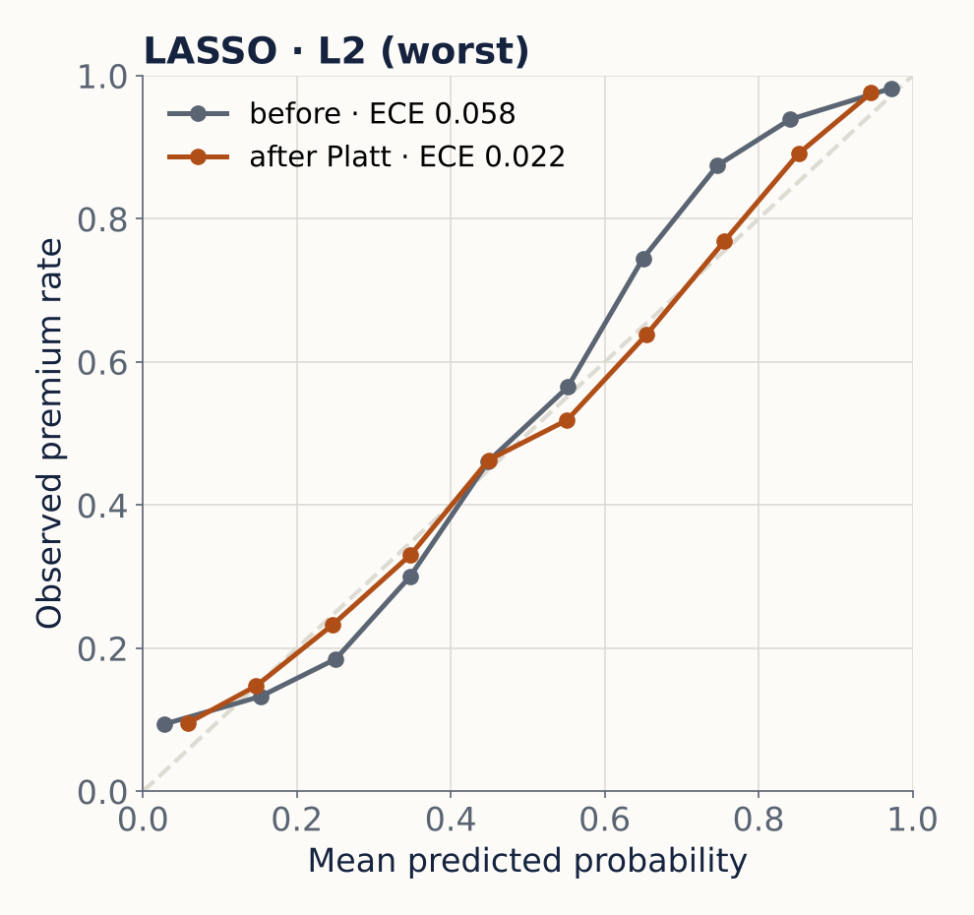
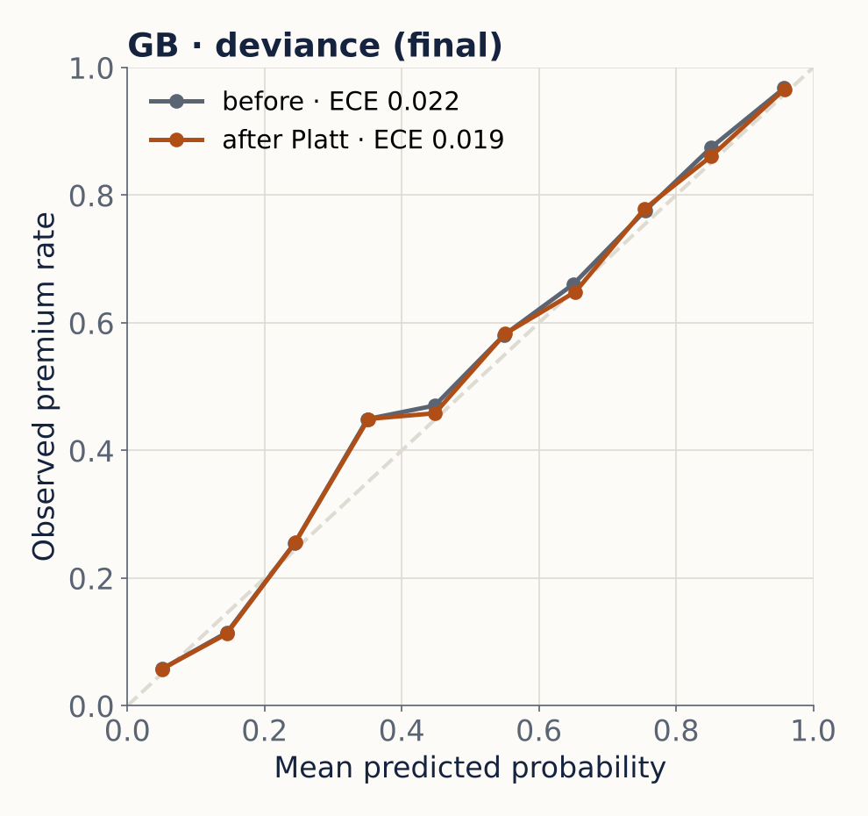
Platt scaling lowers ECE for all four versions
ECE, 10 bins, validation half B
Version | Before | After
LASSO · L2 | 0.058 | 0.022
LASSO · dev. | 0.032 | 0.026
GB · L2 | 0.027 | 0.018
GB · dev. | 0.022 | 0.019
Final model: Platt slope 1.02, intercept 0.03 (near-identity). Its Platt probabilities set the threshold next.
DBA5106 Project 2 · 4 / 6 · Platt fitted on validation half A, judged on half B · Platt is monotonic, so AUC is unchanged
Notes:
Slide 4 · Platt scaling lowers ECE for all four versions
Speaker B · about 2.5 minutes · Brief: calibration via bin evaluation, reliability diagram, ECE; Platt scaling
Thanks. Before choosing a threshold we need honest probabilities. The brief asks us to check calibration with bin evaluation, a reliability diagram and ECE, and to adjust if needed. We did this for all four versions, not just the final one.
The method. Bin evaluation: we sort predictions into ten equal-width bins and compare the average predicted probability in each bin with the share of those flats that actually sold at a premium. The reliability diagram plots one against the other; a calibrated model lies on the diagonal. ECE summarises the gap: the absolute difference in each bin, weighted by the share of flats in that bin.
The adjustment. We used Platt scaling: a one-variable logistic regression on each model's raw score, which is the L2 output or, for deviance models, the log-odds. We fitted it on one half of validation and judged it on the other half, so the improvement is not measured on the data it was fitted to.
Worst case, left: LASSO with L2 loss. Before Platt the curve is S-shaped and wanders off the diagonal in both directions, because squared error on 0/1 labels is not designed to produce probabilities. ECE is 0.058. After Platt it hugs the diagonal, with ECE 0.022.
Our final model, right. It was already close to calibrated, ECE 0.022, because log loss is a proper scoring rule. Platt only nudges it to 0.019; the fitted slope is 1.02 and the intercept 0.03, almost the identity map. The table shows Platt lowered ECE for all four versions, most for the two L2 versions, as theory predicts.
Why it matters. Platt scaling is monotonic, so it does not change AUC or the ranking of flats; model selection is unaffected. But calibration matters for the business. The 0.25 threshold rule only works if a predicted 0.3 really means a 30% chance. And it lets an agent tell a seller, credibly, that flats like theirs sell at a premium about 70% of the time.

Slide 5
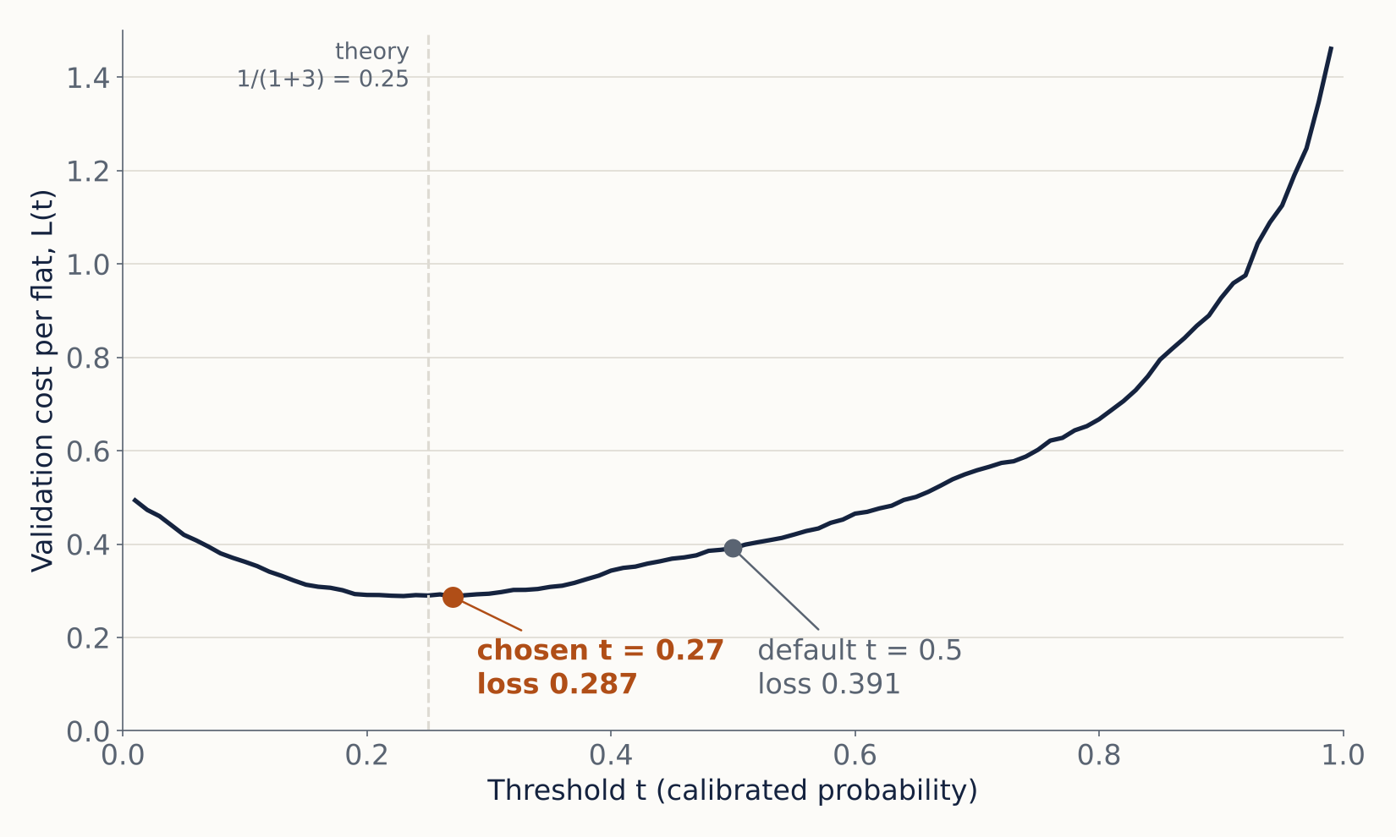
Threshold t = 0.27 cuts test cost by 19%
Test cost per listing
0.328
vs 0.406 at t = 0.5
Missed premium flats (FN)
526
vs 1,056 at t = 0.5
Wasted packages (FP)
1,629
vs 809 at t = 0.5
DBA5106 Project 2 · 5 / 6 · t tuned on validation half B; cards on 2026 test (9,790) · 2:1 → t = 0.30; 5:1 → t = 0.19
Notes:
Slide 5 · Threshold t = 0.27 cuts test cost by 19%
Speaker B · about 2.5 minutes · Brief: threshold that minimises the evaluation loss
Next, the threshold. The brief warns against leaving the threshold at 0.5, so we tuned it to minimise our own evaluation loss.
How. On validation half B, we swept t from 0.01 to 0.99 using the Platt-calibrated probabilities from the previous slide and computed the cost per flat at each value. The curve on the left bottoms out at t = 0.27, with a cost of 0.287, against 0.391 at the default 0.5.
Test result. On the untouched 2026 test set, the cost at 0.27 is 0.328 per flat, against 0.406 at 0.5: a 19% reduction. Two naive rules for context: giving every listing the package costs 0.504, and giving none costs 1.49. Our model beats both.
What it means for the agency. It flags 61% of listings instead of 47%. Missed premium flats fall from 1,056 to 526, about half. Wasted packages rise from 809 to 1,629. That trade is worth making, because each miss costs three times a wasted package.
Why below 0.5. Flag a flat when the expected cost of not flagging, 3 times p, exceeds the expected cost of flagging, 1 times one minus p. That gives p above 0.25. Our tuned 0.27 sits right next to the theory, which also tells us the probabilities are well calibrated.
Is it robust? The 3-to-1 ratio is our assumption, so we tested others. At 2-to-1 the tuned threshold is 0.30, against a theoretical 0.33. At 5-to-1 it is 0.19, against 0.17. The threshold moves the way theory predicts, and the tuned threshold beats 0.5 at every ratio. So our recommendation does not depend on the exact costs: the agency should flag more readily than 50/50.

Slide 6
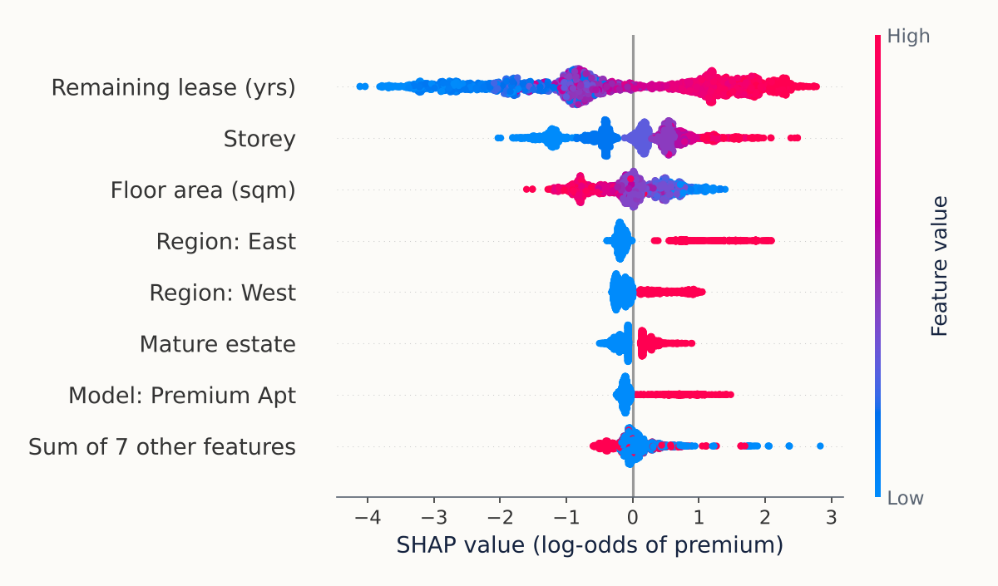
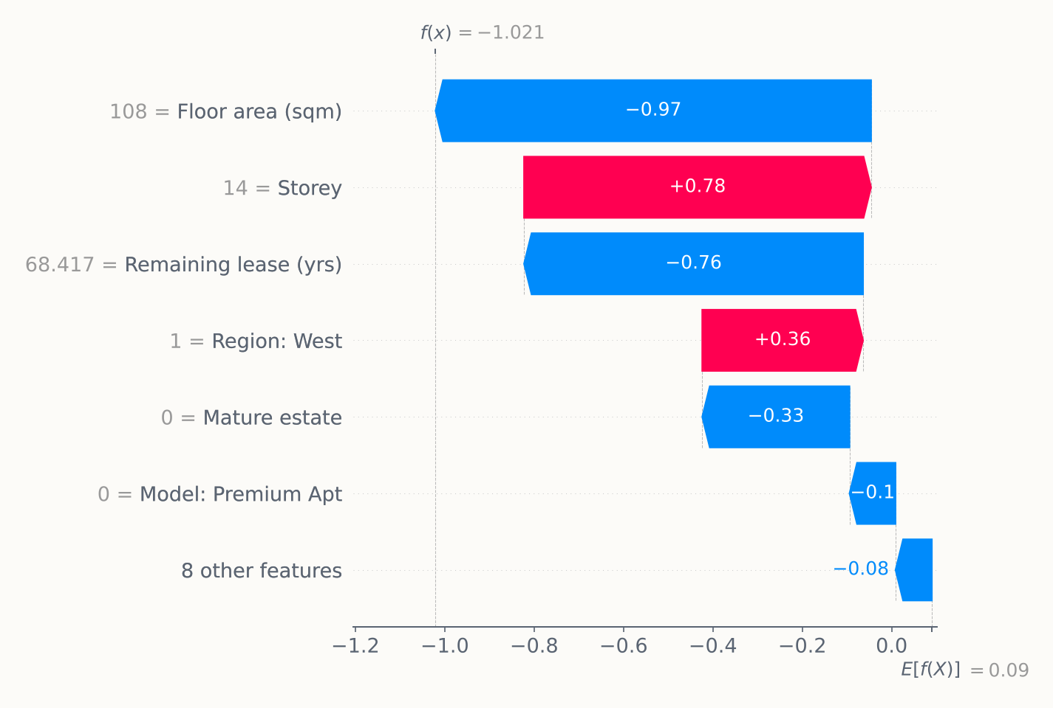
Features determination for decision making
GLOBAL · 3,000 TEST FLATS
LOCAL · MISSED PREMIUM FLAT, P = 0.267 < 0.27
Global
vs LASSO
Recommendation
Longer lease and higher floor raise P(premium); larger area lowers it
Both rank lease first; storey raises P, area lowers P. LASSO weights region more
Use t = 0.27: missed premium flats halve (1,056 → 526)
DBA5106 Project 2 · 6 / 6 · Tree SHAP on GB · deviance (log-odds); regions vs Central · Limits: 3:1 costs assumed; target is relative
Notes:
Slide 6 · Features determination for decision making
Speaker B · about 2.5 minutes · Brief: Tree SHAP on a tree-based blackbox, local and global
Finally, which features drive the decision to flag a flat? The brief requires Tree SHAP on a tree-based blackbox, with a global and a local view. We applied it to our final model, gradient boosting with deviance, on 3,000 test flats.
Global view, left. Each dot is one flat; its position shows how much a feature pushed the log-odds of premium, and colour shows the feature's value. Remaining lease matters most by far: long leases, in red, push toward premium, which fits buyers paying more per square metre for newer flats. Storey is second: higher floors raise the odds. Floor area is third and works the other way: larger flats cost less per square metre, so they are less likely to beat the median. Region and the premium-apartment model matter less.
Local view, right: a premium flat the model missed. It is a 108-square-metre Model A flat in Jurong West, 13th to 15th floor, 68 years of lease left, sold in November 2026 for $530,000. Starting from a base log-odds of 0.09, the high floor adds 0.78, but the large area subtracts 0.97 and the older lease 0.76. Its calibrated probability is 0.267, just below our 0.27 threshold.
Cross-check with the glassbox. Both SHAP and the LASSO coefficients rank lease first, and both say higher floors help and more area hurts, so the blackbox learned a sensible story. They differ on region: LASSO leans on it more, likely because a linear model uses region as a proxy for lease age, while boosting captures that interaction directly.
Recommendations. Use the model with a threshold of 0.27: it halves missed premium flats and cuts cost by 19%.
Limitations. The 3-to-1 costs are assumed, and the target is relative to the town median rather than an absolute price.

